Slide 1




airbnb
Analysis on factors that influence an Airbnb rating
Aurelia Arnett

Slide 2
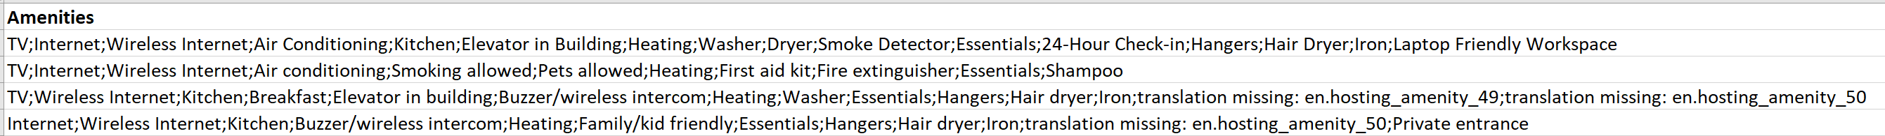
About the data
Structured & unstructured data – a Kaggle dataset
  A spreadsheet containing 1,048,575 Airbnb listings from all around the world in 2017
  Rows include information on Airbnb geography, host response rate, amenities included, and on the accommodations (bedrooms, bathrooms, etc.)
  Rows also include ratings for each listing: an overall rating, cleanliness, accuracy, location and value
  Amenities are strung together in one field:
Semi-structured data – a collection of Tweets

Slide 3
Research questions
Do patterns exist for Airbnb’s with high ratings and with low ratings among regions?
What types of amenities influence Airbnb review ratings?
Can Tweets collected in 2020 reveal new travel trends?
  Between Airbnb and their competitor Vrbo, which Twitter user timeline collection attracts more attention?
  Which travel-related hashtags are trending in 2020?

Slide 4
Data Discovery
Read in 331948 rows of Airbnb listings with credible information
Total superhosts in dataset: 59397 (17.89%):
Superhosts have an average communication rating of 9.89/10 and an average overall rating of 96.46%
Non-superhosts have an average communication rating of 9.38/10 and an average overall rating of 89.59%
Type of Listing
Entire homes have an average overall rating of 91.51%
Shared rooms have an average overall rating of 89.97%
Private rooms have an average overall rating of 81.55%
Accommodations
All Airbnb’s with an overall rating over 90% have on average 1.24 bathrooms and accommodate 3 people
All Airbnb’s with an overall rating under 50% have on average 1.38 bathrooms and accommodate 3 people

Slide 5
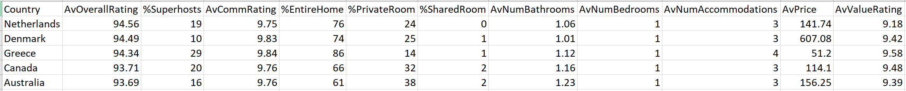
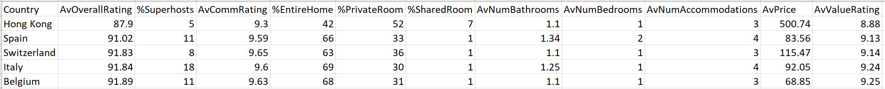
Analysis 1
Data preprocessing: Group Airbnb listings by country
Analysis type: summary
There are 102632 Airbnb’s in the US with an average overall rating of 86.88%
Netherlands: 94.56%
Denmark: 94.49%
Greece: 94.34%
Canada: 93.71%
Australia: 93.69%
•
•
•
Belgium: 91.89%
Italy: 91.84%
Switzerland: 91.83%
Spain: 91.02%
Hong Kong: 87.90%
Results are highlighted and boxed
Countries with the highest overall rating
Countries with the lowest overall rating

Slide 6
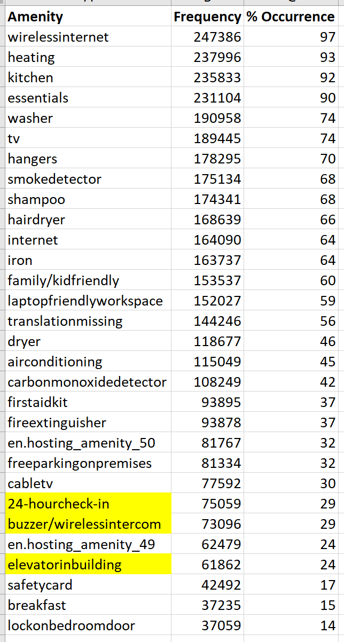
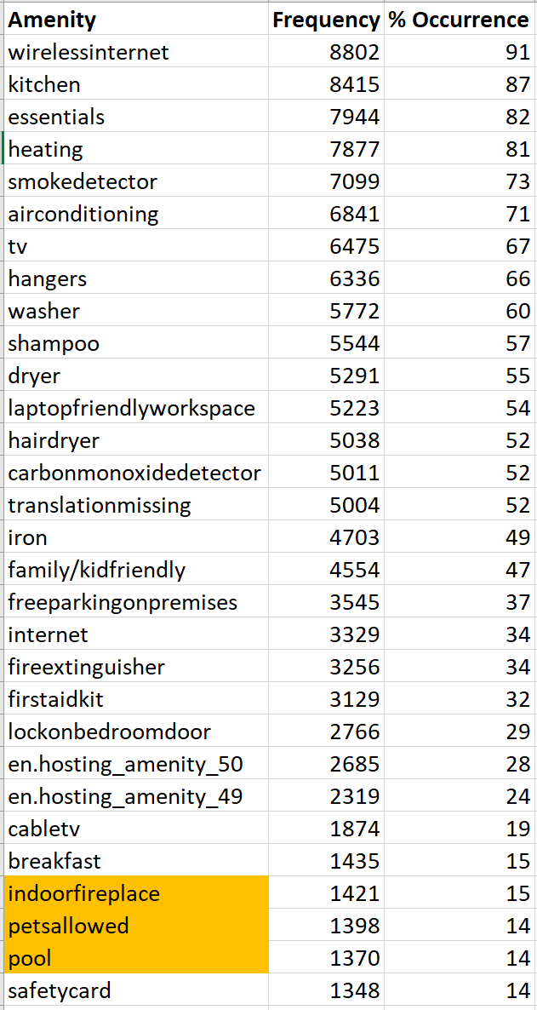
Analysis 2
Data preprocessing: Group listings by Airbnb’s with a rating over 90% and Airbnb’s with a rating under 50%
Analysis type: comparison
Results:
  Airbnb’s that offer 24 hr check-in, a buzzer, and elevator tend to have higher ratings
  Airbnb’s that offer pets and a pool tend to have lower ratings
Airbnb’s over 90%
Airbnb’s under 50%

Slide 7

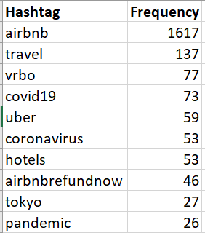
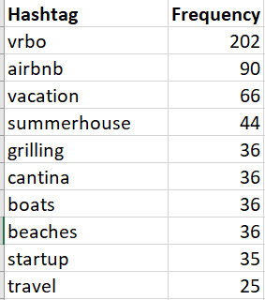
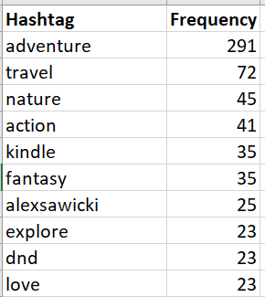
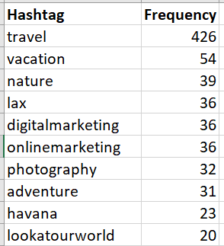
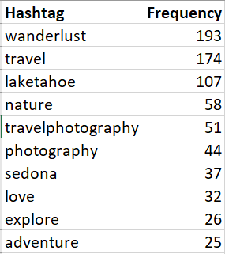
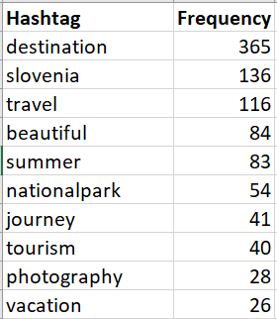
Analysis 3
Data preprocessing: Collection Tweets by timeline and by hashtag
  Tweets by or mentioning @Airbnb and @Vrbo
  Hashtags related to travel terms: Airbnb, Vrbo, adventure, travel, wanderlust, destination
Results are highlighted
Airbnb’s over 90%
#Airbnb
#Vrbo
#adventure
#travel
#wanderlust
#destination

Slide 8
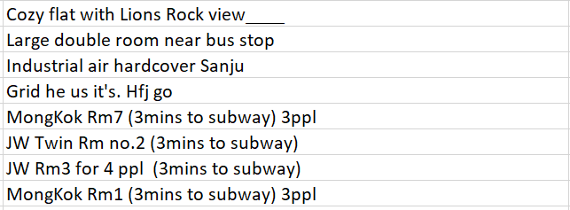
Further Analysis
Analysis on the 50 states
  Accompanying factors appear similar to other countries if left on a country level
Tokenize the Airbnb name:
Decision Tree analysis & data modeling
  Does one factor influence a customer rating? Ex. a previous high/low rating rather than basing off their personal experience
An analysis on factors offered by Vrbo
  Is there a reason Vrbo is tweeted at more often than Airbnb?

Slide 9
Q & A

